Slide 1

MCTS Guide to Microsoft Windows 7
Chapter 1
Introduction to Windows 7

Slide 2
Objectives
Describe the versions of Windows 7
Discuss the new features in Windows 7
Understand the Windows 7 user interface
Define the hardware requirements and understand the hardware support of Windows 7
Describe the application support built in to Windows 7
Identify essential connectivity applications used in Windows 7
Understand the networking models supported by different versions of 7

Slide 3
Windows 7 Versions
Four mainstream versions of Windows 7
  Windows 7 Home Premium
  Windows 7 Professional
  Windows 7 Enterprise
  Windows 7 Ultimate
Additional specialized versions
  Windows 7 Starter
  Windows 7 Home Basic
  Windows 7 N & K Editions

Slide 4
Windows 7 Home Premium
Home users who want richer multimedia experience
Includes:
  Aero interface
  Support for up to 2 physical CPUs
  Support for tablet PCs and MultiTouch controls
  Windows Media Center capabilities
  Creation and use of HomeGroups
  Windows Mobility Center
  Network printing
  Internet Connection Sharing

Slide 5
Windows 7 Professional
Allows a business to simplify its operations
  And concentrate on doing business
Features include:
  64-bit version supports up to 192 GB RAM
  Remote Desktop hosting
  Support for domain networking
  Location aware printing
  Dynamic disks
  Windows XP Mode with Windows Virtual PC
  • Volume licensing

Slide 6
Windows 7 Enterprise
Available only to customers who purchase Software Assurance (SA) from Microsoft
Includes the features found in Windows 7 Professional and adds:
  Multiple Language User Interface for companies spanning the globe
  UNIX-based application support
  BitLocker Drive Encryption
  Enhancements to remote corporate data access

Slide 7
Windows 7 Ultimate
Provides the same feature set as Windows 7 Enterprise
  Combining all of the features of a home and business operating system
Only retail edition that provides functionality that is closely matched to Windows 7 Enterprise

Slide 8
Windows 7 Starter
Limited in features and reduced in cost
  For buyers of computers with reduced hardware specifications
Some of the features not included:
  Aero Glass interface
  Support for multiple monitors
  DVD playback
  Ability to join a corporate network domain
  Windows Media Center and media streaming
  64-bit version

Slide 9
Windows 7 Home Basic
Capable of running on limited hardware at a competitive price point
Includes the features of Windows 7 Starter and adds:
  Partial Aero functionality
  Multiple monitor support
  Windows Mobility Center
  Network printing
  Internet connection sharing
  64-bit version

Slide 10
Windows 7 N & K Editions
N releases
  Sold in countries that do not allow Microsoft to bundle in Windows Media Player and other media software as part of the operating system
K releases
  Only sold in South Korea
  Also have some features removed, such as Windows Media Player

Slide 11
Enhanced Features in Windows 7
Features include:
  32- and 64-bit Computing Support
  Aero
  .NET Framework
  Speech Recognition
  User Account Control
  Fast User Switching Enhancements
  Windows Driver Foundation
  Repair and Restart Improvements
  Rapid Deployment
  Windows BitLocker Drive Encryption
  Trusted Platform Modules Services
  Network Connectivity

Slide 12
32- and 64-Bit Computing Support
Windows 7 comes in both 32-bit and 64-bit processor versions
64-bit version of Windows 7
  Can support up to 192 GB of RAM
  Has a greater theoretical limit for processing data
  Not all software and hardware is compatible with the 32-bit and 64-bit editions
Windows 7 Upgrade Advisor
  Utility available from Microsoft to analyze the suitability of a computer to run Windows 7

Slide 13
Aero
Visual theme first introduced with Windows Vista
Offers a new pleasing user experience
  Simple, easy to learn, and fun
Hardware and software requirements
  Video card with at least 128 MB of RAM (256 MB recommended)
  Graphics card driver must support:
    A minimum of DirectX9.0
    The new Windows Display Driver Model (WDDM)

Slide 14
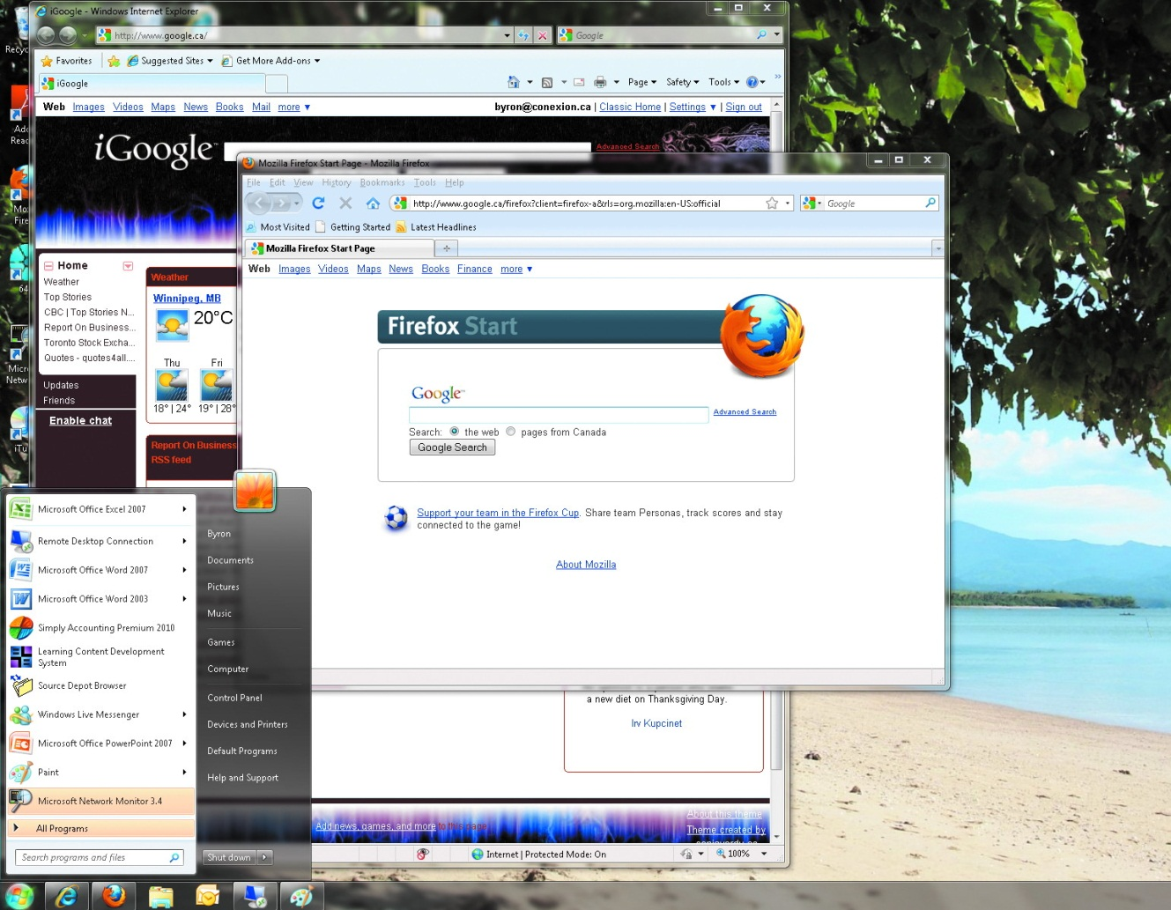
Aero (cont'd.)

Slide 15
.NET Framework
Defines multiple Application Programming Interfaces (API) including:
  Windows Presentation Foundation
    Allows applications to draw to the screen
  Windows Communication Foundation
    Allows applications to communicate with each other
  Windows Workflow Foundation
    Allows developers to build applications that follow a logical sequence of events
  Windows CardSpace
    Protects a user’s digital identities

Slide 16
Speech Recognition
Input method beyond the keyboard and mouse
System is trainable, supports spoken corrections, and multiple languages
Commands to perform typical Windows operations are built in

Slide 17
User Account Control
User Account Control
  Allows security level for an account to be fine-tuned
    Based on how trusted the user and computer environment are
Instead of using the Run As feature
  Users can be prompted by Windows 7 for administrator approval
To avoid frequent administrative prompts
  Windows 7 has added new privileges to the standard user account

Slide 18
Fast User Switching Enhancements
Windows XP introduced fast user switching
  Ability for multiple users to log in to the same computer at the same time
  Users can then toggle between themselves without having to log out or close applications
Windows 7 supports fast user switching in both the workgroup mode and the domain mode
Windows 7 allows fast user switching even when the computer is joined to the domain

Slide 19
Windows Driver Foundation
Windows Driver Foundation (WDF) architecture
  Replaces the older Windows Driver Model (WDM)
  Defines how device driver software operates
With WDM, drivers spend much of their time interacting with the OS instead of the hardware
Driver software has access to the computer’s hardware at two distinct levels
  Kernel and user mode
Kernel mode drivers
  Have direct access to all hardware and memory

Slide 20
Windows Driver Foundation (cont'd.)
User mode drivers
  Have restricted access and must pass a request to the operating system
User mode driver architecture is defined under WDF
  In addition to kernel mode drivers
If the user mode driver fails
  It can be restarted without causing the core, or kernel, of the operating system to crash with it
WDF drivers support distributed computing

Slide 21
Repair and Restart Improvements
Many services that fail in Windows 7 are designed to restart automatically
  Without significantly disrupting service to the user
If multiple services depend on each other and one service fails
  Windows 7 can restart the affected services without having to reboot the computer
Common repair action
  Update applications, drivers, and operating system code

Slide 22
Rapid Deployment
Windows 7 components are designed to be modular and selectable
Windows Imaging Format (WIM)
  Technology used to distribute Windows 7 installation files
Files necessary to install Windows 7 or end user applications can be compiled into a single WIM file
  Acting as a library

Slide 23
Windows BitLocker Drive Encryption
BitLocker Drive Encryption
  Adds the ability to securely encrypt the hard drive’s contents at a hardware level

Slide 24
Trusted Platform Module Services
Trusted Platform Module (TPM) architecture
  Defines options for adding firmware and hardware to computers to detect low-level tampering
    Before the operating system starts
Optional hardware such as smart cards and USB keys holding digital identification can be used
  As part of the TPM solution to make sure that stolen computers can’t be started
    Or have their hard drive decrypted

Slide 25
Network Connectivity
TCP/IP Networking
  Windows 7 supports IPv6
  Teredo
    Software client to support IPv4 to IPv6 translation
Network Location Awareness Service
  Operating system and its applications must be aware of the networks around them
  Applications can track what network services are available using the NLA service as a central reference
  Can report status and performance of each network

Slide 26
Network Connectivity (cont'd.)
Windows Firewall
  Windows firewall software has been enhanced to restrict connections in both directions
  Connections can be permitted or restricted
Location Aware Printing
  Windows 7 can assign a new default printer based on the network location when the network connection is established

Slide 27
User Interface Features
Start button
Windows Help and Support
Search Interface
Gadgets
Taskbar
Notification Area
Advanced Window Management

Slide 28
Start Button
The way the Start menu opens has changed
  Goal is to stop the menu from sprawling across the user’s screen
  As the user moves from one level to another, the list above the Start button is replaced
    With the next selected level’s program icons
Jump Lists
  New feature introduced in Windows 7
  Identify what content was recently opened by an application, or what content is automatically linked to the menu item

Slide 29
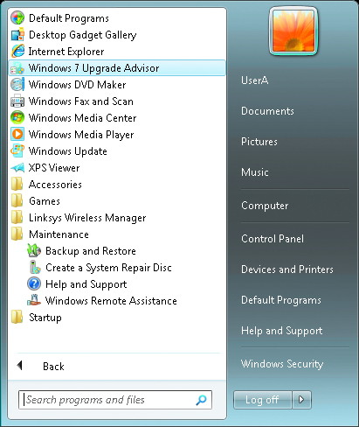
Start Button (cont'd.)

Slide 30
Windows Help and Support
Designed to include more methods in one utility to help users find the solution they need
Help and Support interface allows users to:
  Initiate a Remote Assistance call
  Post a question to a newsgroup
  Search other databases
  Look up phone numbers for Microsoft support

Slide 31
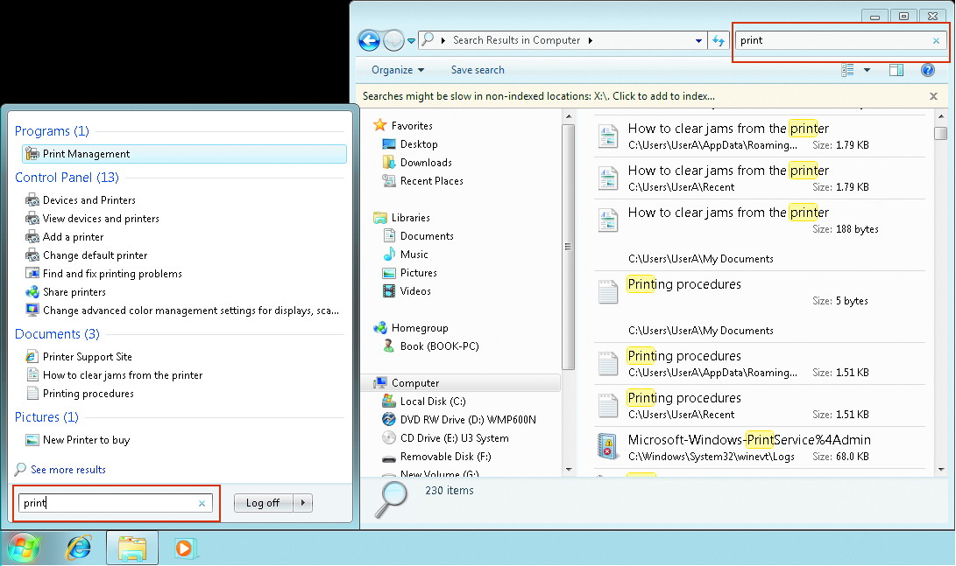
Search Interface

Slide 32
Taskbar
Taskbar
  Horizontal bar located at the bottom of the screen by default
  Contains the Start button to the left and the notification area to the right
  In the middle is an area to keep track of open windows
Preview of each window the application has open will be displayed above the taskbar button
Taskbar buttons can represent a shortcut to an application, even if it isn’t actively running

Slide 33
Notification Area
Area located to the right of the taskbar in the bottom right-hand side of the Windows 7 screen
Area has been simplified by default to display the clock and icons for volume, network connectivity, power, and Action Center notifications
Action Center notifications
  List important operating system messages in one convenient place
Other applications can add icons to the notification area, but they are not displayed automatically

Slide 34
Advanced Window Management
Snap
  Allows windows to quickly be resized by having the user click on the title bar of the window and drag it to the top, sides, or middle of the screen
Shake
  Only available in versions of Windows 7 that are using the Aero theme
  If a user clicks on the title bar of a window and shakes the mouse from side to side, all other windows will automatically minimize

Slide 35
Hardware Requirements and System Hardware Support
Windows 7 is designed to provide a different look and feel
  Depending on the version of the operating system and the capabilities of the system’s hardware
Component manufacturers who want their product to be tested with Windows 7
  Can submit their solution to the Windows Hardware Quality Labs (WHQL)

Slide 36
Hardware Requirements and System Hardware Support (cont'd.)
System Component | Recommendation
CPU | 32 or 64 processor, 1 Ghz or faster
System RAM | 1 GB (2GB for a computer with 64-bit CPU
Disk Space | 16 Gb for 32 bit, 20 GB for 64 bit
Video Card Drivers | DirectX 9 graphical processor with WDDM 1.0 (or higher)

Slide 37
Processor Support
Processes and Threads
  Program instructions are typically grouped into units of code called threads
  Threads and processes are common terms used to describe what the CPU is working on
  Multitasking
    Gives the appearance that the computer is running multiple applications or processes at the same time
  Preemptive multitasking
    Allows a single process to be interrupted by another process, even if the first process has not completed

Slide 38
Processor Support (cont'd.)
Processes and Threads (cont'd.)
  Quantum: time window a thread is allowed to run
  Processor affinity
    Thread is restricted to which CPU can run it
  Windows programs are usually written modularly
  Code modules are saved in Dynamic Link Library files (DLLs)
  Code modules in the DLLs can be shared between applications

Slide 39
Processor Support (cont'd.)
Multiple Processor Support
  Multiprocessor systems
    Have more than one physical CPU
    Each additional CPU allows the computer to process instructions in parallel, at the same time
Hyper-Threading Support
  Hyper-Threading
    CPUs have extra hardware built in to allow more than one thread to be processed at the same time
      On a single CPU
  Each thread runs in its own virtual space

Slide 40
Processor Support (cont'd.)
Multi-Core Support
  Threads created by applications can limit themselves so that only one thread can execute
    CPU cannot use its extra hardware
  Multi-core CPUs
    CPU package physically looks like one CPU
      But internally contains multiple CPU cores
    Each CPU core is capable of running its own thread
    Cores share some connections to the rest of the computer
      Performance may suffer

Slide 41
Plug and Play
Plug and Play technology
  Assumes that hardware components can be connected or activated at any time
    While the operating system is running
Device driver is automatically loaded by the plug and play system
  And the hardware is available for use

Slide 42
Power Management
Computers powered by Windows 7 and meeting the latest hardware power standards
  Can consume less power than ever before
Power savings is realized by exposing more power management features to device drivers
  Allow those drivers to better integrate with the OS
New low-power sleep modes use a combination of:
  Deactivating hardware components
  Buffering the current state of the computer to disk

Slide 43
Tablet Hardware
Windows 7 Home Premium, Professional, Enterprise, and Ultimate Editions support tablet computers
Tablet computer
  Similar to a laptop in its portability, but it does not rely on a traditional keyboard for data entry
Handwriting recognition is improved in Windows 7
  Can learn the personal writing style of a user
Frequent menu actions can be assigned to specific flicks of the input pen

Slide 44
Media Hardware
Windows 7 Home Premium, Professional, and Ultimate Editions support Windows Media Center
  Allows the computer to become part of a full entertainment system

Slide 45
Multiple Monitor Support
Support has been enhanced to enable less user involvement when multiple displays are detected
Screen hardware can provide EDID (Extended Display Identification Data) information to the computer
Video hardware and device driver software installed to operate it must be compatible with Windows 7
  To fully operate as a multi-monitor setup

Slide 46
Networking Technologies
Network Cards
  Windows 7 has redesigned networking support for the large data streams
Wireless Networks
  Wireless networking built on Wi-Fi standards is considered native to the operating system
  Network Diagnostic Framework
    Aids automatically diagnosing problems with the wireless connection
  Wireless connections can be configured with command-line utilities

Slide 47
Disk Technology
Physical disk storage can be connected to a computer internally or externally
  Using connection technology such as: IDE, SATA, SCSI, or USB
Virtual hard disks are supported by Windows 7

Slide 48
Disk Partition Styles
When a computer is first started, firmware starts first
Firmware
  Built in code to initialize the hardware and load an operating system
BIOS
  Oldest style of firmware
  Recognizes the MBR partition style
UEFI
  Newer and alternate type of firmware
  Recognizes the GPT partition style

Slide 49
Types of Disk Partitions
Basic disks
  Desktop computers commonly have a single hard disk that stores the operating system, applications, and user data
Dynamic disk
  Microsoft partitioning scheme
  Only the Windows 7 Professional, Enterprise, and Ultimate Editions support dynamic disks

Slide 50
File Systems
FAT16
  File Allocation Table (FAT) file system is an older file system that is supported for backward compatibility
FAT32
  Uses a 32-bit numbering system to increase the number of data blocks that can be managed
exFAT
  For portable flash memory devices with more than 32GB of space
NTFS
  New version of NT File System (NTFS)

Slide 51
File Systems (cont'd.)
CD-ROM File System (CDFS)
  Introduced with Windows NT 4
  Has been replaced with UDF as a preference for formatting removable media such as CDs and DVDs
Universal Disk Format (UDF)
  A third-party standard that defines how to store data on removable media such as DVDs

Slide 52
Compatibility Settings
Available as an application property after installed
Windows 7 can emulate the following environments:
  Windows 95
  Windows 98/ME
  Windows NT 4 SP5
  Windows 2000
  Windows XP SP2 & SP3
  Windows Server 2003 SP1
  Windows Server 2008 SP1
  Windows Vista SP1 & SP2

Slide 53
Program Compatibility Wizard
Has the ability to guide the user through different compatibility settings
  If unsuccessful, reports the results to Microsoft
Can be started by right-clicking a program icon
  Select Troubleshoot compatibility from the pop-up menu

Slide 54
Application Compatibility Toolkit
Application Compatibility Toolkit (ACT)
  Free tool from Microsoft to help IT administrators
    Discover which of their existing applications are compatible with Windows 7

Slide 55
Windows XP Mode with Windows Virtual PC
Virtual PC product
  Free from Microsoft
  Allows the creation of a virtual computer system that runs as an application hosted on Windows 7
  Allows a user to run an older version of Windows inside the virtual computer
  Shares the computer’s hardware with Windows 7
Windows XP Mode
  Allows the applications installed in the Windows Virtual machine to show up on the Windows 7 Start Menu

Slide 56
Kernel and User Mode
Provides better application isolation
Kernel mode access
  Has total access to all of data and hardware
  If a software component crashes
    There is little the operating system can do to stop it or recover
User mode access
  Has access to its own private space and nothing else
Kernel supports more types of software running at a user level instead of a kernel level
Ring level
  Describes security levels at the CPU hardware level
    From Ring 0 (least restricted) to 3 (most restricted)

Slide 57
Connectivity Applications
Applications include:
  Remote Desktop
  Remote Assistance
  Network Projection
  HomeGroups

Slide 58
Remote Desktop
Included with Windows 7 Professional, Enterprise, and Ultimate Editions
Allows a user to remotely connect to their computer using the remote desktop client over TCP/IP

Slide 59
Remote Assistance
Stand-alone application included with all versions of Windows 7
User can ask for help from a trusted professional over the network
Easy Connect
  Allows a computer to be discovered over the Internet using a generated password and the IPv6 network protocol

Slide 60
Network Projection
Included with Windows 7 Professional, Ultimate, and Enterprise Editions
Allows user to connect to network-attached projectors over wired and wireless networks

Slide 61
HomeGroups
Provide a mechanism to easily share printers, pictures, music, videos, and documents
  With other Windows 7 computers using a shared wired or wireless network at home
Each computer that joins the HomeGroup system must present a valid HomeGroup password

Slide 62
Networking Models
Networking models supported by Windows 7:
  Workgroup Model
  Domain Model
  Windows Peer-to-Peer Networking

Slide 63
Workgroup Model
Workgroup
  Loosely knit collection of peer computers on a network
  No computer has control over any other computer
Each computer is identified by its name and address on the network
Default workgroup name is typically WORKGROUP
Workgroup design is traditionally known as a peer-to-peer networking model
Managing a workgroup can be difficult
Computers in a workgroup are usually part of a single local area network
  Operating with direct access between each computer
Workgroups should be limited to 10 to 20 computers

Slide 64
Domain Model
Client/server strategy that allows central administrative management of its members
Domain
  Collection of computers and users that are identified by a common security database
    The database is stored on one or more dedicated servers called Domain Controllers (DC)
Each domain member can have client or server role
Typically employed in business environments

Slide 65
Domain Model (cont'd.)
Windows NT Domains
  Original Microsoft Domain Model was introduced with Windows NT
  Two types of DCs exist for a Windows NT domain
    Primary DC (PDC)
      Allowed to make changes to the domain database
    Backup DC (BDC)
      Maintains a read-only copy of the database
  Supports up to a few thousand computers per domain

Slide 66
Domain Model (cont'd.)
Active Directory Domains
  Domain database is still stored on dedicated Domain Controller (DC) servers
  Multi-master replication
    All DCs are capable of updating the database and replicating those changes
  Use Domain Name System (DNS) technology
  Can define more than one domain as part of the same system
  Manage user and computer environment of members

Slide 67
Windows Peer-to-Peer Networking
Similar in concept to the traditional workgroup model
  But technically different
Makes peer-to-peer infrastructure scalable from the LAN to the Internet
  As long as they communicate using IPv6
Teredo allows IPv6 traffic to be embedded in legacy IPv4 traffic
Peer Name Resolution Protocol (PNRP) is used by Windows Peer-to-Peer Networking clients
  To discover each other

Slide 68
Summary
Windows 7 is available in five versions
New Aero style adds an exciting visual element that applications can take advantage of using the .NET Framework 3.5 code model
Windows 7 offers a streamlined Start menu interface that does not sprawl across the screen
Minimum hardware requirements must be met
Compatible hardware is listed on the Windows Marketplace tested products list

Slide 69
Summary (cont'd.)
Application support in Windows 7 is designed to work on more than one level
Networks enable data sharing between computers
  Windows 7 also enables the user to share computers and resources
Windows 7 can participate in the workgroup or domain networking models

